Slide 1
Automated Vending Machine
Group 11: Mayank Baranwal, Udbhav Chugh, Hardik Katyal, Kartik Gupta

Slide 2
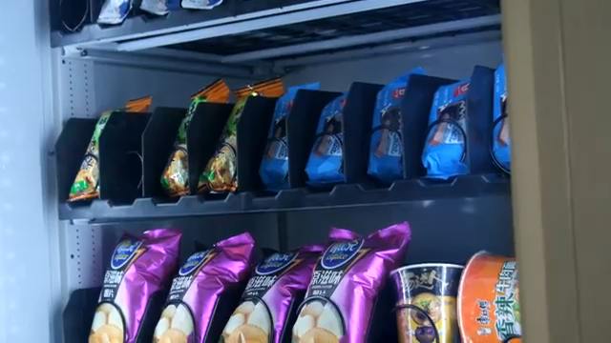
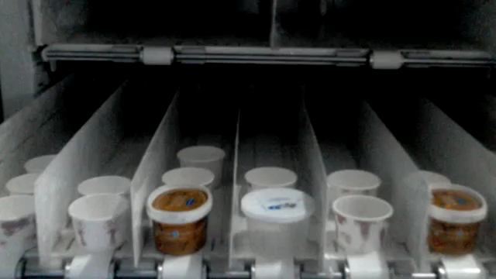
Object Retrieval Mechanism
Helical Spring
Conveyer Belt

Slide 3
Features and Sensors
Features
Sensors + Equipment
Instructor authentication while inserting objects
RFID authentication of users
Rationing of equipment (prevent hoarding)
Inform instructor on shortage of equipment
Ensure 1 item released/rotation
Rasperry Pi
Colour Sensor
Matrix Keypad
RFID Reader
Proximity Sensor
Wifi Dongle with Antenna
Servo Motor – x4
Helical spring/ Conveyer Belt

